Slide 1

ABFRL Brands-Shopping Flow App Tagging
11th October 2023

Slide 2
Guidelines to Implement Tagging
Adobe Launch SDK should be implemented to trigger the custom events
Copy and paste the contextData as it is without changing the Camel Casing.
All values should be passed in lowercase.
Track State(Page Load Event) and Track Action(Non-Page Load event) should be fired along with the contextData.
Context data should be fired with specific event.
<> this indicates dynamic value to be captured and passed.
Testing will be performed by DWAO after ABFRL QA team will give the confirmation/sign off for the testing done by them.
UAT should be done first in staging and then in production post-production UAT adobe’s codes are pushed to live.
Product Category value should be consistent for every product for entire website.
For Customer ID, pass the value only when available else pass it as blank.

Slide 3

Cart

Slide 4
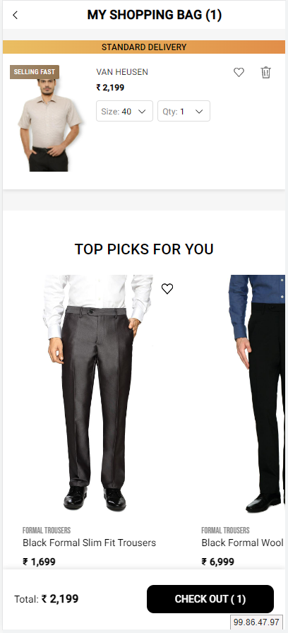
On cart page load

Slide 5
Page Type | Tracking Type | Launch variables | Expected Values
Cart Page | onload/Update | let contextData={ pageName: "cart page", channel: "<android/ios>|cart", customerID : "<customerID>", // only pass when available loginStatus : "<logged-in/guest>" , pageType : "cart page”, &&events: "scView,event 16,event13,event14,event15,event61,event22=<total Products available in the cart>“, &&products : ";<product 1 id>;;;event13=<product 1 marked price>|event14=<product 1 selling price>|event15=<product 1 discount amount>|event61=<product 1 quantity>;eVar19 = <product 1 category>|eVar30=<product 1 name>|eVar32=<product 1 brand name>| eVar33= <product 1 stockStatus>|eVar34=< product 1 color>|eVar35=<product 1 size>|eVar36= <product 1 genderType>|eVar44=<product 1 style code>,;<product 2 id>;;;event13=<product 2 marked price>|event14=<product 2 selling price>|event15=<product 2 discount amount>|event61=<product 2 quantity>;eVar19 = <product 2 category>|eVar30=<product 2 name>|eVar32=<product 2 brand name>| eVar33=<product 2 stockStatus>|eVar34= <product 2 color>|eVar35=<product 2 size>|eVar36= <product 2 genderType>|eVar44=<product 2 style code>,....;<product N id>;;;event13=<product N marked price>|event14=<product N selling price>|event15=<product N discount>|event61=<product N discount amount>;eVar19 = <product N category>|eVar30=<product N name>|eVar32=<product N brand name>| eVar33= <product N stockStatus>|eVar34= <product N color>|eVar35=<product N size>|eVar36=<product N genderType>|eVar44=<product N style code>”, platform: "<android/ios>", userDetails: "<gender>|<age>", // pass only when user has logged in dob: "<date of birth>" // pass only when user is logged in // pass only when user has logged in } ACPCore.trackState(“cart page", contextData); | loginStatus may have the values:- logged-in guest productID: will have the value of SKU ID of the product. productCategory: will have the category of the product. Example:- shirt trouser productMarkPrice: will contain the MRP of the product. productSellPrice: will contain the actual selling price of the product. productQuantity: will have the quantity selected for the product. productName: name of the product. brandName: name of the brand of the product. stockStatus: provide whether product is instock or out of stock eg – stockStatus : “out of stock” or “available” color: example values: Red. size: example values:- 42 L styleCode: will contain the style code of the product. Example value:- PESFONUB236782 productDiscount will have the discount applied on the product. productGenderType Example value:- female

Slide 6
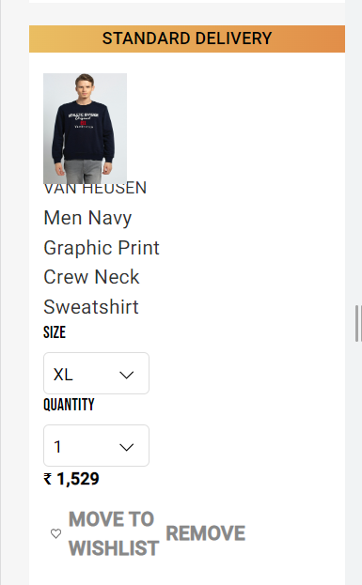
On increasing/decreasing the product quantity

Slide 7
Click Type | Tracking Type | Launch variables | Expected Values
Product Increment | dropdown button | let contextData={ linkName:“<product quantity increased/product quantity decreased>", channel:"<android/ios>|cart", linkPageName: "cart page", customerID : "<customerID>", // only pass when available loginStatus : "<logged-in/guest>" , platform: "<android/ios>", userDetails: "<gender>|<age>", // pass only when user is logged in dob: "<date of birth>" // pass only when user is logged in }; ACPCore.trackAction(“<product quantity increased/product quantity decreased>", contextData); | loginStatus may have the values:- logged-in guest

Slide 8
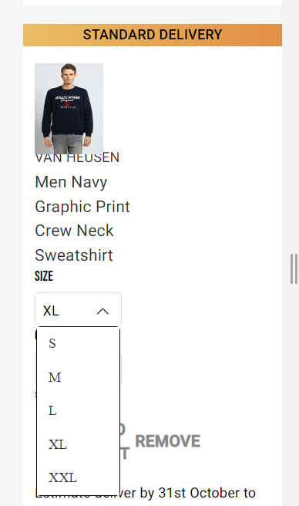
On changing the selected size

Slide 9
Click Type | Tracking Type | Launch variables | Expected Values
Size change | dropdown button | let contextData={ linkName:"product size change", channel:"<android/ios>|cart", linkPageName: "cart page", customerID : "<customerID>", // only pass when available loginStatus : "<logged-in/guest>" , &&events: “event17" &&products : ";<product id>;;;;eVar19 =<product category>|eVar30=<product name>|eVar32=<product brand name>|eVar33=<product stock status>|eVar35=<product size>”, platform: "<android/ios>", userDetails: "<gender>|<age>", // pass only when user is logged in dob: "<date of birth>" // pass only when user is logged in }; ACPCore.trackAction(“product size change", contextData); | loginStatus may have the values:- logged-in guest productID: will have the value of SKU ID of the product. productCategory: will have the category of the product. Example:- shirt trouser productName: name of the product. stockStatus: provide whether product is instock or out of stock eg – stockStatus : “out of stock” or “available” size: example values:- 42 L

Slide 10
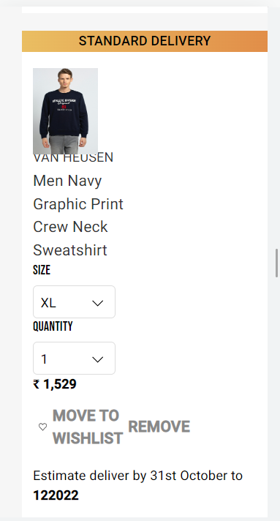
On removing the product

Slide 11
Click Type | Tracking Type | Launch variables | Expected Values
Product Removal | icon | let contextData={ linkName:"<cta name>", channel:"<android/ios>|cart", linkPageName: "cart page", &&events : “scRemove, event13,event14,event15,event61,event23”, customerID : "<customerID>", // only pass when available loginStatus : "<logged-in/guest>" , &&products : ";<product id>;;;event13=<product marked price>|event14=<product selling price>|event15=<product discount amount>|event61=<product quantity>;eVar19 = <product category>|eVar30=<product name>|eVar32=<product brand name>|eVar33=<product stockStatus>|eVar34=<product color>|eVar35=<product size>|eVar36=<product genderType>|eVar44=<product style code>”, platform: "<android/ios>", userDetails: "<gender>|<age>", // pass only when user is logged in dob: "<date of birth>" // pass only when user is logged in }; ACPCore.trackAction(“<cta name>", contextData); | loginStatus may have the values:- logged-in guest productID: will have the value of SKU ID of the product. productCategory: will have the category of the product. Example:- shirt trouser productMarkPrice: will contain the MRP of the product. productSellPrice: will contain the actual selling price of the product. productQuantity: will have the quantity selected for the product. productName: name of the product. brandName: name of the brand of the product. stockStatus: provide whether product is instock or out of stock eg – stockStatus : “out of stock” or “available” color: example values: Red. size: example values:- 42 L styleCode: will contain the style code of the product. Example value:- PESFONUB236782 productDiscount will have the discount applied on the product. productGenderType Example value:- Female

Slide 12
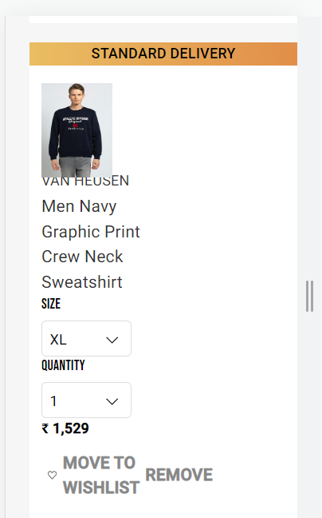
On moving the product to Wishlist

Slide 13
Click Type | Tracking Type | Launch variables | Expected Values
Move to Wishlist | icon | let contextData={ linkName:"<cta name>", channel:"<android/ios>|cart", linkPageName: "cart page", customerID : "<customerID>", // only pass when available loginStatus : "<logged-in/guest>" , &&events : “event4”, &&products : ";<product id>;;;;eVar19 =<product category>|eVar30=<product name>| eVar32=<product 1 brand name>”, platform: "<android/ios>", platform: "<android/ios>", userDetails: "<gender>|<age>", // pass only when user is logged in dob: "<date of birth>" // pass only when user is logged in }; ACPCore.trackAction(“<cta name>", contextData); | loginStatus may have the values:- logged-in guest productID: will have the value of SKU ID of the product. productCategory: will have the category of the product. Example:- shirt trouser productName: name of the product.

Slide 14
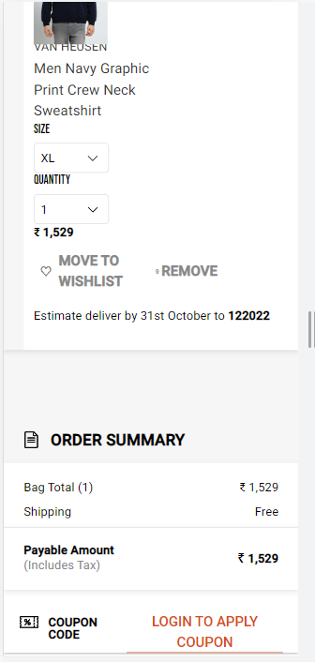
Login to apply coupon

Slide 15
Click Type | Tracking Type | Launch variables | Expected Values
Login to apply coupon | CTA | let contextData={ linkName:"<cta name>", channel: "<android/ios>|cart", linkPageName: "cart page", customerID : "<customerID>", // only pass when available loginStatus : "<logged-in/guest>" , platform: "<android/ios>", userDetails: "<gender>|<age>", // pass only when user is logged in dob: "<date of birth>" // pass only when user is logged in }; ACPCore.trackAction(“<cta name>", contextData); | loginStatus may have the values:- logged-in guest

Slide 16
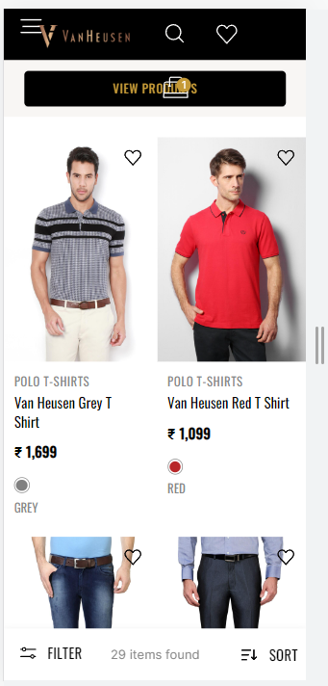
On selecting products from Top Picks

Slide 17
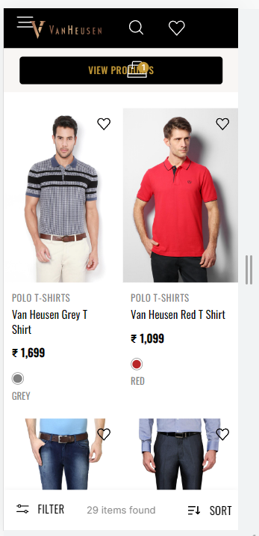

Slide 18
Page Type | Tracking Type | Launch variables | Expected Values
Product Click | All CTAs | let contextData={ linkName: "product click", channel:"<android/ios>|cart", linkPageName: "cart page", customerID : "<customerID>", // only pass when available loginStatus : "<logged-in/guest>" , &&products : ";<product id>;;;;eVar19 = <product category>|eVar30=<product name>|eVar32=<product brand name>|eVar33=<product stock status>|eVar35=<product size>|eVar23=<product position>”, pfm : “<section of the page/ product finding source>”, platform: "<android/ios>", userDetails: "<gender>|<age>", // pass only when user is logged in dob: "<date of birth>" // pass only when user is logged in }; ACPCore.trackAction(“product click", contextData); | loginStatus may have the values:- logged-in guest pfm means product finding method, the expected values will be the section of the page from where the user has found the product. Eg : “home product slider” “internal search” “internal campaign” “similar products” “top picks” “breadcrumb” “navigation/browsing” “promos” “wishlist/favorites” “collections” “cross-Sell” “campaign landing pages” productID: will have the value of SKU ID of the product. productCategory: will have the category of the product. Example:- shirt trouser productName: name of the product. stockStatus: provide whether product is instock or out of stock eg – stockStatus : “out of stock” or “available”. size: example values:- 42 L

Slide 19
On Add /Remove Wishlist from Top Picks

Slide 20
Click Type | Tracking Type | Launch variables | Expected Values
Add to wishlist | Icon | let contextData={ linkName: “<add to wishlist/remove from wishlist>", channel:"<android/ios>|cart", linkPageName: "cart page", customerID : "<customerID>", // only pass when available loginStatus : "<logged-in/guest>" , &&events: “<event4/event5>” // event4 only when add to Wishlist and event5 only when remove from Wishlist &&products : ";<product id>;;;;eVar19 = <product category>|eVar30=<product name>|eVar32=<product brand name>”, platform: "<android/ios>", userDetails: "<gender>|<age>", // pass only when user is logged in dob: "<date of birth>" // pass only when user is logged in }; ACPCore.trackAction(“<add to wishlist/remove from wishlist>", contextData) | loginStatus may have the values:- logged-in guest productID: will have the value of SKU ID of the product. productCategory: will have the category of the product. Example:- shirt trouser productName: name of the product. For removeWishlist : replace “event4” with “event5”

Slide 21
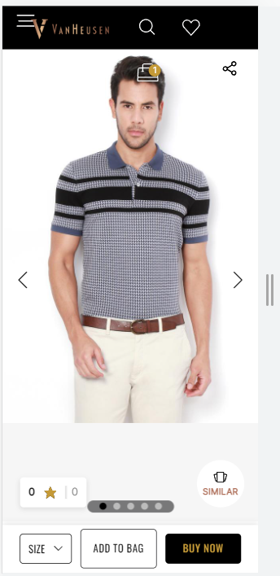
On click of Similar products

Slide 22
Click Type | Tracking Type | Launch variables | Expected Values
Similar | Button | let contextData={ linkName: "similar product", channel:"<android/ios>|cart", linkPageName: "cart page", customerID : "<customerID>", // only pass when available loginStatus : "<logged-in/guest>" , platform: "<android/ios>", userDetails: "<gender>|<age>", // pass only when user is logged in dob: "<date of birth>" // pass only when user is logged in }; ACPCore.trackAction(“similar product", contextData) | loginStatus may have the values:- logged-in guest

Slide 23
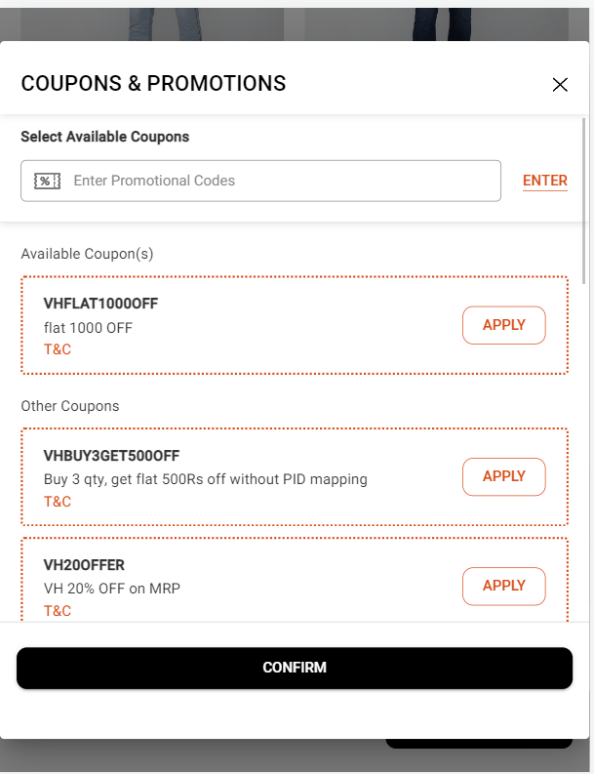
On load of Coupons & Promotions

Slide 24
Page Type | Tracking Type | Launch variables | Expected Values
Coupons and promotions | Pop-up View | var let contextData={}; let contextData={ pageName:"coupons and promotions", parentPage: "cart page" channel:"<android/ios>|cart", customerID : "<customerID>", // only pass when available loginStatus : "<logged-in/guest>" , pageType : "shopping page - cart" platform: "<android/ios>", userDetails: "<gender>|<age>" // pass only when user has logged in }; ACPCore.trackState(“coupons and promotions", contextData); | loginStatus may have the values:- logged-in guest

Slide 25
On click of Enter

Slide 26
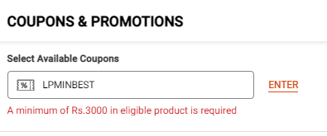
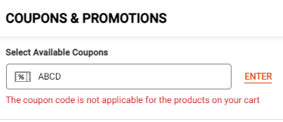
Click Type | Tracking Type | Launch variables | Expected Values
Enter Coupon | Hyperlink and Button | let contextData={ linkName:"<cta name>", channel: "<android/ios>|cart", &&events : “<event18/event19/event20>” // event18 only when a user applies a coupon. event19 only when a coupon has been successfully applied. event20 only when a coupon shows any error. appliedCouponCode: "<coupon code>-<brand name>", invalidCouponCode: “<coupon code>-<brand name>-<error message>”//when selected coupon is not applied and error message comes. Refer to expected values linkPageName: "coupons & promotions", parentPage: "cart page", customerID : "<customerID>", // only pass when available loginStatus : "<logged-in/guest>" , platform: "<android/ios>", appliedCouponCode: "<coupon code>-<brand name>", userDetails: "<gender>|<age>" // pass only when user is logged in }; ACPCore.trackAction(“<cta name>", contextData); | loginStatus may have the values:- logged-in guest If invalid code is brand specific, eg: invalidCouponCode: “lpminbest-aoe-a minimum of Rs.3000 in eligible product is” If invalid code has no brand, pass brand as ‘NA’, eg: invalidCouponCode: “abcd-na-the coupon code is not applicable for the products cart” For click of Enter button: appliedCouponCode: If a coupon is applied as per below example:- If coupon code is NEW100 worth of Rs100 for f21. Then the value will be: “new100-f21“ For click of Confirm button: appliedCouponCode: If coupons applied as per below example:- If coupon code 1 is NEW100 worth of Rs100 for f21, coupon 2 is NEW200 for sc. Then the value will be: “new100-f21| new200-sc” (because there can be more than one coupon on the time of click of confirm)

Slide 27
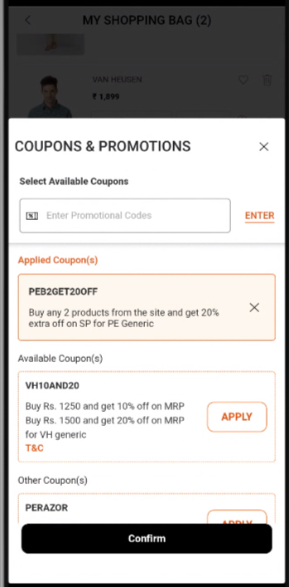
Coupon removal from Coupon pop-up

Slide 28
Click Type | Tracking Type | Launch variables | Expected Values
Cart Checkout | button | let contextData={ linkName:"<coupon remove>", channel: "web|cart", linkPageName: "coupons & promotions", parentPage: "cart page", customerID : "<customerID>", // only pass when available loginStatus : "<logged-in/guest>" , platform: "<desktop website/mobile website>", couponDetails: "<coupon code>-<coupon brand name>,//details of the coupon removed userDetails: "<gender>|<age>" // pass only when user is logged in dob: "<date of birth>" // pass only when user is logged in }; ACPCore.trackAction(“<coupon remove>", contextData); | loginStatus may have the values:- logged-in guest

Slide 29
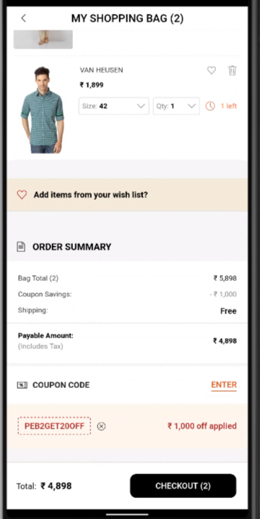
Coupon Removal from cart

Slide 30
Click Type | Tracking Type | Launch variables | Expected Values
Cart Checkout | button | let contextData={ linkName:"<coupon remove>", channel: "web|cart", linkPageName: “cart page", parentPage: "cart page", customerID : "<customerID>", // only pass when available loginStatus : "<logged-in/guest>" , platform: "<desktop website/mobile website>", couponDetails: "<coupon code>-<coupon brand name>,//details of the coupon removed userDetails: "<gender>|<age>" // pass only when user is logged in dob: "<date of birth>" // pass only when user is logged in }; ACPCore.trackAction(“<coupon remove>", contextData); | loginStatus may have the values:- logged-in guest

Slide 31
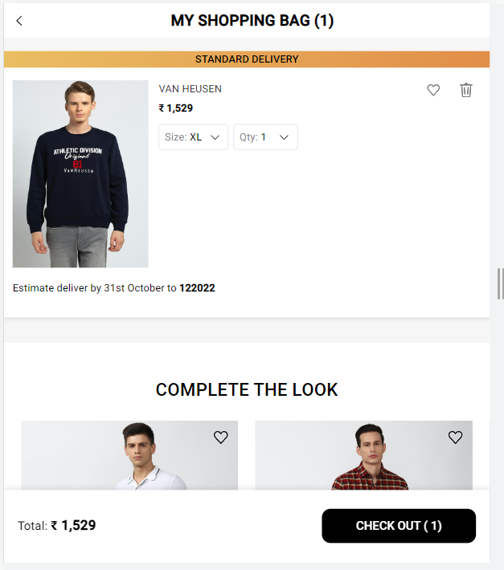
Cart Checkout

Slide 32
Click Type | Tracking Type | Launch variables | Expected Values
Cart Checkout | button | let contextData={ linkName: "<cta name>", channel: "<android/ios>|cart", linkPageName: "cart page", customerID : "<customerID>", // only pass when available loginStatus : "<logged-in/guest>" , platform: "<android/ios>", userDetails: "<gender>|<age>", // pass only when user is logged in dob: "<date of birth>" // pass only when user is logged in }; ACPCore.trackAction(“<cta name>", contextData); | loginStatus may have the values:- logged-in guest

Slide 33
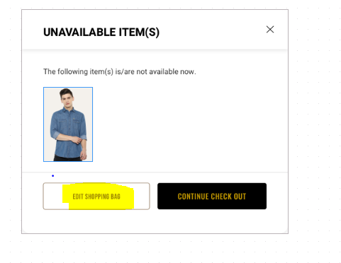
Unavailable items pop-up load

Slide 34
Page Type | Tracking Type | Launch variables | Expected Values
Unavailable items during checkout | Pop-up View | let contextData={ pageName:“unavailable items", parentPage: "cart page“, channel:"<android/ios>|cart", customerID : "<customerID>", // only pass when available loginStatus : "<logged-in/guest>" , pageType : "shopping page - cart“, &&events: “event13,event14,event15,event61,event24,event25=<number of items unavailable>”, &&products : ";<product 1 id>;;;event13=<product 1 marked price>|event14=<product 1 selling price>|event15=<product 1 discount amount>|event61=<product 1 quantity>;eVar19 = <product 1 category>|eVar30=<product 1 name>|eVar32=<product 1 brand name>| eVar33= <product 1 stockStatus>|eVar34=< product 1 color>|eVar35=<product 1 size>|eVar36= <product 1 genderType>|eVar44=<product 1 style code>,;<product 2 id>;;;event13=<product 2 marked price>|event14=<product 2 selling price>|event15=<product 2 discount amount>|event61=<product 2 quantity>;eVar19 = <product 2 category>|eVar30=<product 2 name>|eVar32=<product 2 brand name>| eVar33=<product 2 stockStatus>|eVar34= <product 2 color>|eVar35=<product 2 size>|eVar36= <product 2 genderType>|eVar44=<product 2 style code>,....;<product N id>;;;event13=<product N marked price>|event14=<product N selling price>|event15=<product N discount>|event61=<product N discount amount>;eVar19 = <product N category>|eVar30=<product N name>|eVar32=<product N brand name>| eVar33= <product N stockStatus>|eVar34= <product N color>|eVar35=<product N size>|eVar36=<product N genderType>|eVar44=<product N style code>”, platform: "<android/ios>", userDetails: "<gender>|<age>" // pass only when user has logged in dob: "<date of birth>" // pass only when user is logged in }; ACPCore.trackState(“unavailable items", contextData); | //pass product details only of those products which are unavailable/out of stock in the cart. loginStatus may have the values:- logged-in guest loginStatus may have the values:- logged-in guest productID: will have the value of SKU ID of the product. productCategory: will have the category of the product. Example:- shirt trouser productMarkPrice: will contain the MRP of the product. productSellPrice: will contain the actual selling price of the product. productQuantity: will have the quantity selected for the product. productName: name of the product. brandName: name of the brand of the product. stockStatus: provide whether product is instock or out of stock eg – stockStatus : “out of stock” or “available” color: example values: Red. size: example values:- 42 L styleCode: will contain the style code of the product. Example value:- PESFONUB236782 productDiscount will have the discount applied on the product. productGenderType Example value:- Female

Slide 35
Click of Edit Shopping/Continue Checkout

Slide 36
Click Type | Tracking Type | Launch variables | Expected Values
Edit Shopping/Continue Checkout | All CTAs | let contextData={ linkName: "<cta name>", channel: "<android/ios>|cart", linkPageName: “unavailable items", parentPage: "cart page", customerID : "<customerID>", // only pass when available loginStatus : "<logged-in/guest>" , platform: "<android/ios>", userDetails: "<gender>|<age>", // pass only when user is logged in dob: "<date of birth>" // pass only when user is logged in }; ACPCore.trackAction(“<cta name>", contextData) | loginStatus may have the values:- logged-in guest

Slide 37

Checkout

Slide 38
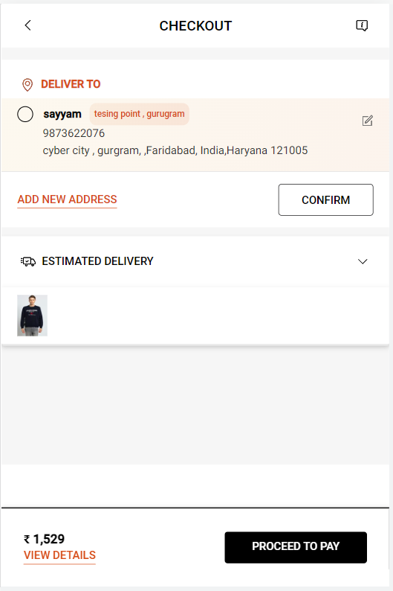
Checkout-Step 1 Load

Slide 39
Page Type | Tracking Type | Launch variables | Expected Values
Checkout Page | onload | var let contextData={}; let contextData={ pageName: “checkout page", parentPage : "checkout page", channel: "<android/ios>|checkout", &&events : “scCheckout,event13,event14,event15,event61,event26”, customerID : "<customerID>", loginStatus : "<logged-in>", pageType : "checkout page“ &&products : ";<product 1 id>;;;event13=<product 1 marked price>|event14=<product 1 selling price>|event15=<product 1 discount amount>|event61=<product 1 quantity>;eVar19 = <product 1 category>|eVar30=<product 1 name>|eVar32=<product 1 brand name>| eVar33= <product 1 stockStatus>|eVar34=< product 1 color>|eVar35=<product 1 size>|eVar36= <product 1 genderType>|eVar44=<product 1 style code>,;<product 2 id>;;;event13=<product 2 marked price>|event14=<product 2 selling price>|event15=<product 2 discount amount>|event61=<product 2 quantity>;eVar19 = <product 2 category>|eVar30=<product 2 name>|eVar32=<product 2 brand name>| eVar33=<product 2 stockStatus>|eVar34= <product 2 color>|eVar35=<product 2 size>|eVar36= <product 2 genderType>|eVar44=<product 2 style code>,....;<product N id>;;;event13=<product N marked price>|event14=<product N selling price>|event15=<product N discount>|event61=<product N discount amount>;eVar19 = <product N category>|eVar30=<product N name>|eVar32=<product N brand name>| eVar33= <product N stockStatus>|eVar34= <product N color>|eVar35=<product N size>|eVar36=<product N genderType>|eVar44=<product N style code>”, platform: "<android/ios>", userDetails: "<gender>|<age>", dob: "<date of birth>" }; ACPCore.trackState(“checkout delivery address", contextData); | loginStatus may have the values:- logged-in guest productID: will have the value of SKU ID of the product. productCategory: will have the category of the product. Example:- shirt trouser productMarkPrice: will contain the MRP of the product. productSellPrice: will contain the actual selling price of the product. productQuantity: will have the quantity selected for the product. productName: name of the product. brandName: name of the brand of the product. stockStatus: provide whether product is instock or out of stock eg – stockStatus : “out of stock” or “available” color: example values: Red. size: example values:- 42 L styleCode: will contain the style code of the product. Example value:- PESFONUB236782 productDiscount will have the discount applied on the product. productGenderType Example value:- female couponCode If a coupon is applied as per below example:- If coupon code is NEW100 worth of 100 Rs for f21. Then the value will be: "NEW100-f21-100|OFF50-sc-500”.

Slide 40
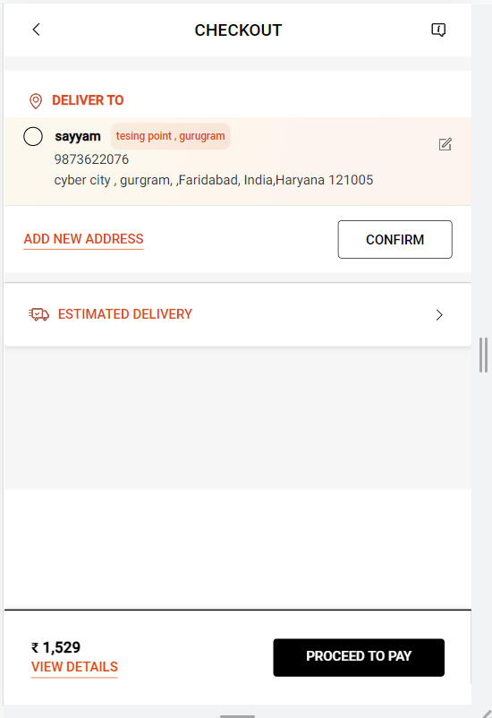
On click of back arrow on checkout

Slide 41
Click Type | Tracking Type | Launch variables | Expected Values
Shopping Bag/ Back | button | let contextData={ linkName: “shopping bag", channel: "<android/ios>|checkout", linkPageName: "checkout page", parentPage : "checkout page", channel: "<android/ios>|checkout", customerID : "<customerID>", platform: "<android/ios>", userDetails: "<gender>|<age>“ dob: "<date of birth>" } ACPCore.trackAction(“shopping bag", contextData) | loginStatus may have the values:- logged-in guest

Slide 42
On click of Add New Address

Slide 43
Click Type | Tracking Type | Launch variables | Expected Values
Add new address | button | let contextData={ linkName: "add new address", channel: "<android/ios>|checkout", linkPageName: "checkout delivery address", customerID : "<customerID>", loginStatus : "logged-in" , platform: "<android/ios>", userDetails: "<gender>|<age>", dob: "<date of birth>" }; ACPCore.trackAction(“add new address", contextData); | loginStatus may have the values:- logged-in guest

Slide 44
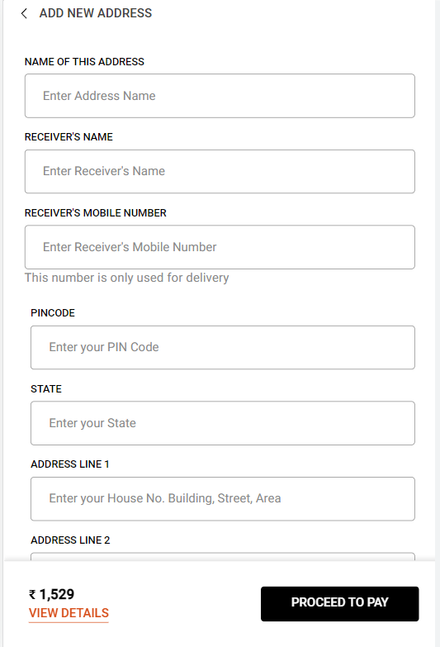
New Address on Load

Slide 45
Page Type | Tracking Type | Launch variables | Expected Values
New Address Form | View | var let contextData={}; let contextData={ pageName: "add new address", parentPage: "checkout page", channel:"<android/ios>|checkout", customerID : "<customerID>", loginStatus : "logged-in" , pageType : "checkout page" platform: "<android/ios>", userDetails: "<gender>|<age>", dob: "<date of birth>" }; ACPCore.trackState(“add new address ", contextData); | loginStatus may have the values:- logged-in guest

Slide 46
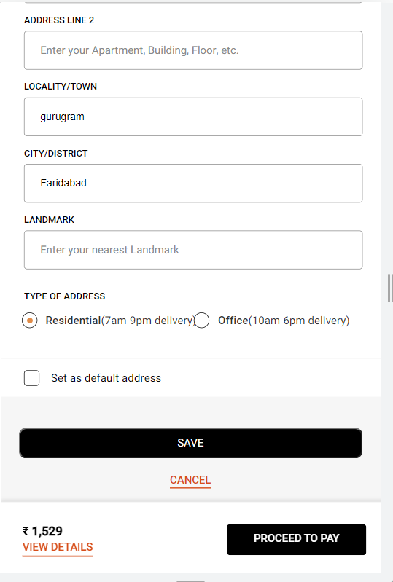
On click of Save Button

Slide 47
Click Type | Tracking Type | Launch variables | Expected Values
Multiple clicks | button | let contextData={ linkName: "<cta name>", channel:"<android/ios>|checkout", linkPageName: "checkout delivery address", parentPage: "checkout page", customerID : "<customerID>", loginStatus : "logged-in" , platform: "<android/ios>", userDetails: "<gender>|<age>", dob: "<date of birth>" }; ACPCore.trackAction(“<cta name>", contextData) | loginStatus may have the values:- logged-in Guest <ctaName> will be the button name to be passed as the value.

Slide 48
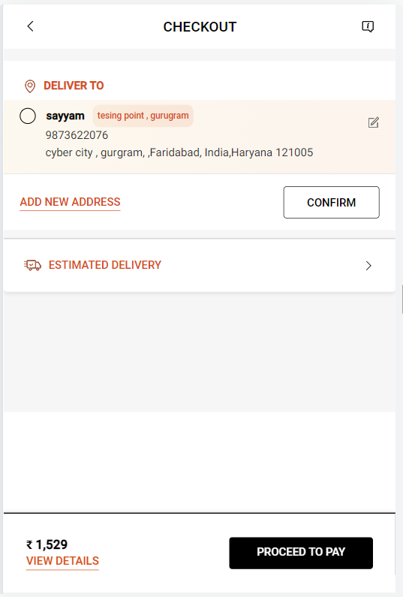
On Click of Edit Address

Slide 49
Page Type | Tracking Type | Launch variables | Expected Values
Multiple clicks | CTA | let contextData={ linkName: "<cta name>", channel:"<android/ios>|checkout", linkPageName: "checkout delivery address", customerID : "<customerID>", loginStatus : "logged-in" , platform: "<android/ios>", userDetails: "<gender>|<age>", dob: "<date of birth>" }; ACPCore.trackAction(“<cta name>", contextData) | loginStatus may have the values:- logged-in guest

Slide 50
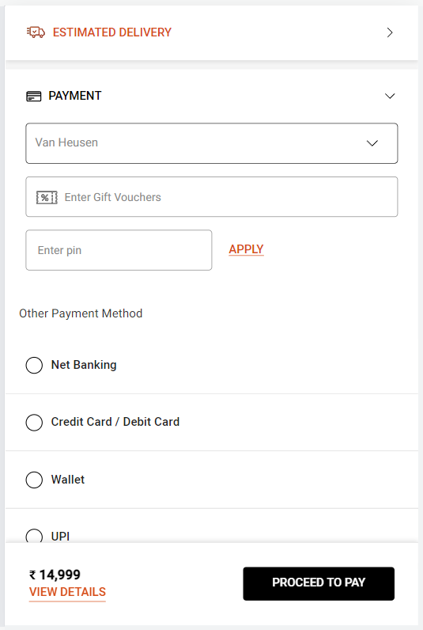
Checkout- Step2 Load

Slide 51
Page Type | Tracking Type | Launch variables | Expected Values
Payment Method | onLoad | let contextData={ pageName: "checkout payment method", parentPage: "checkout page", channel: "<android/ios>|checkout", customerID : "<customerID>", loginStatus : "<logged-in>", pageType : "checkout page", platform: "<android/ios>", userDetails: "<gender>|<age>", dob: "<date of birth>" }; ACPCore.trackState(“checkout payment method", contextData); | loginStatus may have the values:- logged-in guest

Slide 52
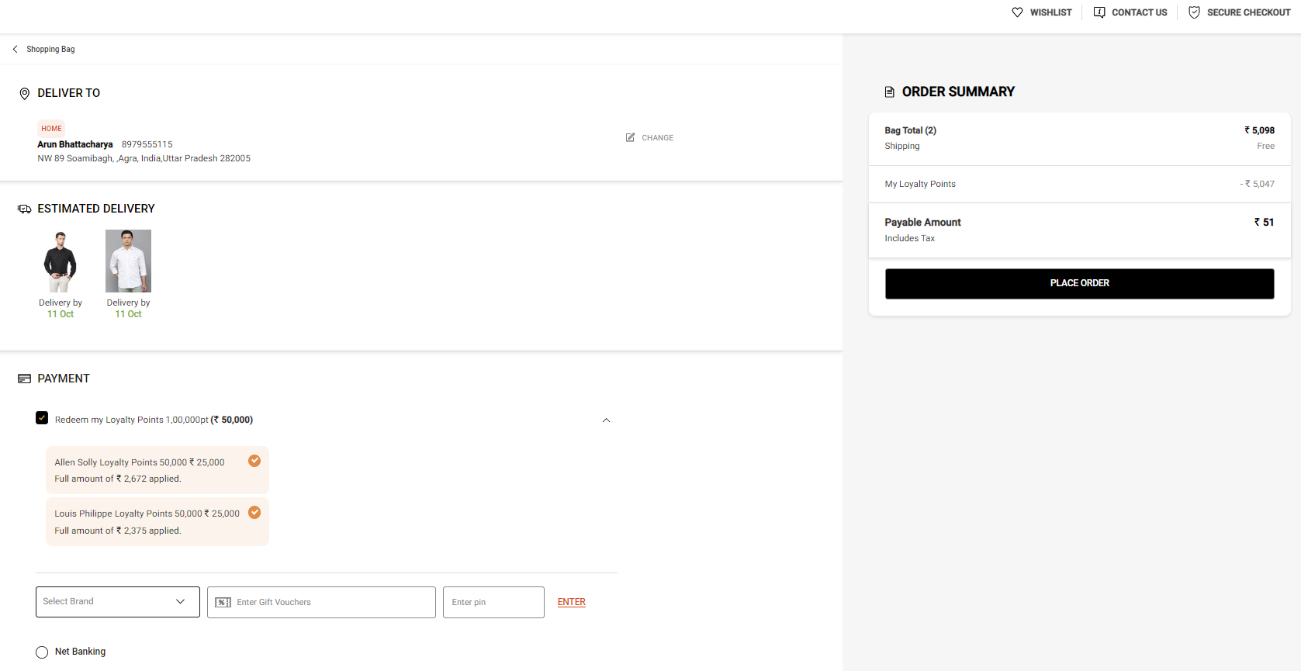
On clicking on Change Address Button

Slide 53
Click Type | Tracking Type | Launch variables | Expected Values
Change Selected Address | CTA | let contextData={ linkName:"change address", channel:"<android/ios>|checkout", linkPageName: "checkout delivery address", customerID : "<customerID>", loginStatus : "logged-in" , pageType : "checkout page", platform: "<android/ios>", userDetails: "<gender>|<age>", dob: "<date of birth>" }; ACPCore.trackAction(“change address", contextData) | loginStatus may have the values:- logged-in guest

Slide 54
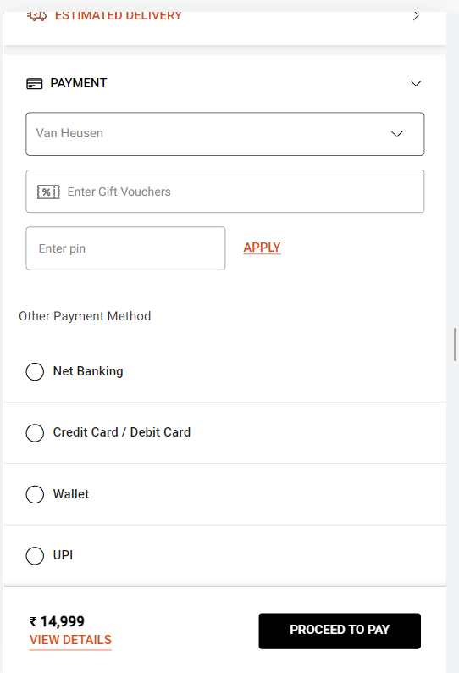
On Applying gift voucher

Slide 55
Click Type | Tracking Type | Launch variables | Expected Values
Gift voucher | button | let contextData={ linkName:"<cta name>", channel:"<android/ios>|checkout", linkPageName: "checkout payment method", customerID : "<customerID>", loginStatus : "logged-in" , pageType : "checkout page", appliedGiftVoucher: "<voucher code>-<brand name>-<voucher amount>", platform: "<android/ios>", userDetails: "<gender>|<age>", dob: "<date of birth>" }; ACPCore.trackAction(“<cta name>", contextData) | loginStatus may have the values:- logged-in guest appliedGiftVoucher: If a gift voucher is applied as per below example:- If gift voucher is NEW200 worth of 200 Rs for f21. Then the value will be: "NEW200-f21-200"

Slide 56
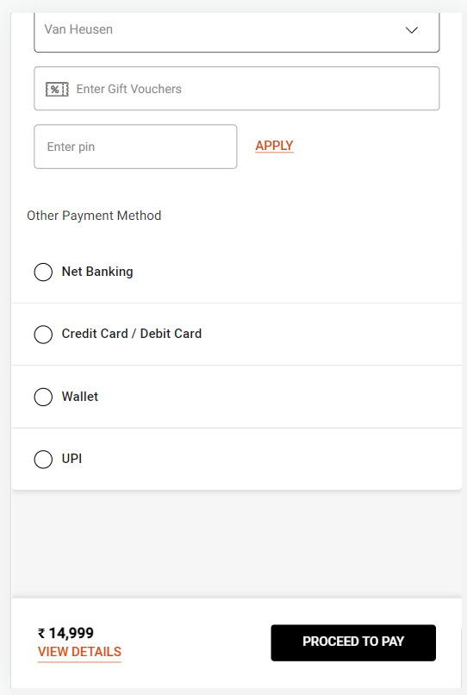
On click of payment option

Slide 57
Click Type | Tracking Type | Launch variables | Expected Values
Payment option selection | Radio button | let contextData={ linkName:"<payment method>", channel:"<android/ios>|checkout", linkPageName: "checkout payment method", customerID : "<customerID>", loginStatus : "logged-in" , pageType : "checkout page", platform: "<android/ios>", userDetails: "<gender>|<age>", dob: "<date of birth>" }; ACPCore.trackAction(“<payment method>", contextData) | loginStatus may have the values:- logged-in guest

Slide 58
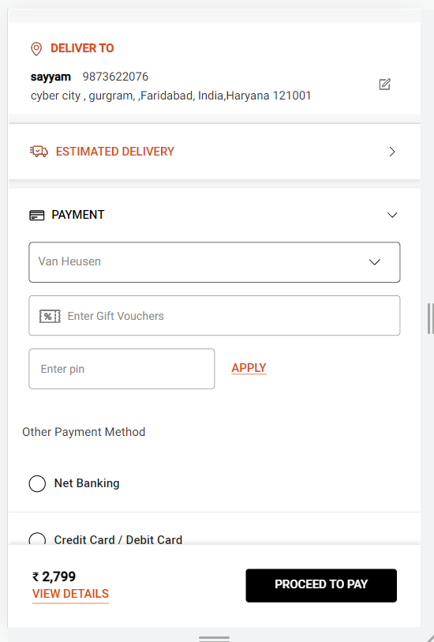
On click of Place order

Slide 59
Click Type | Tracking Type | Launch variables | Expected Values
Place Order | button | let contextData={ linkName: “<cta name>", channel:"<android/ios>|checkout", linkPageName: "checkout payment method", customerID : "<customerID>", loginStatus : "logged-in" , pageType : "checkout page", &&events : “event31,event13,event14,event15,event61,event62=<number of total Products initiated for order>”, &&products : "<;product 1 id;product 1 quantity;product 1 selling price;event13=product 1 marked price|event14=product 1 selling price|event15=product 1 discount amount|event61=product 1 quantity;eVar19 = product 1 category|eVar30=product 1 name|eVar32=product 1 brand name| eVar33= product 1 stockStatus|eVar34= product 1 color|eVar35=product 1 size|eVar36= product 1 genderType|eVar44=product 1 style code,;product 2 id;product 2 quantity;product 2 selling price;event13=product 2 marked price|event14=product 2 selling price|event15=product 2 discount amount|event61=product 2 quantity;eVar19 = product 2 category|eVar30=product 2 name|eVar32=product 2 brand name| eVar33= product 2 stockStatus|eVar34= product 2 color|eVar35=product 2 size|eVar36= product 2 genderType|eVar44=product 2 style code,....;product N id;product N quantity;product N selling price;event13=product N marked price|event14=product N selling price|event15=product N discount|event61=product N discount amount;eVar19 = product N category|eVar30=product N name|eVar32=product N brand name| eVar33= product N stockStatus|eVar34= product N color|eVar35=product N size|eVar36= product N genderType|eVar44=product N style code>, platform: "<android/ios>", userDetails: "<gender>|<age>", dob: "<date of birth>" }; ACPCore.trackAction(“<cta name>", contextData) | loginStatus may have the values:- logged-in guest productID: will have the value of SKU ID of the product. productCategory: will have the category of the product. Example:- shirt trouser productMarkPrice: will contain the MRP of the product. productSellPrice: will contain the actual selling price of the product. productQuantity: will have the quantity selected for the product. productName: name of the product. brandName: name of the brand of the product. stockStatus: provide whether product is instock or out of stock eg – stockStatus : “out of stock” or “available” color: example values: Red. size: example values:- 42 L styleCode: will contain the style code of the product. Example value:- PESFONUB236782 productDiscount will have the discount applied on the product. productGenderType Example value:- female couponCode If a coupon is applied as per below example:- If coupon code is NEW100 worth of 100 Rs for f21. Then the value will be: "NEW100-f21-100|OFF50-sc-500”. voucherCode If a gift voucher is applied as per below example:- If gift voucher is NEW200 worth of 200 Rs for aoe. Then the value will be: "NEW200-f21-200|DIWALI40-sc-700“ loyaltyAmount If a loyalty amount is applied as per below example:- If total loyalty amount available is Rs1000 and Rs900 is used for f21. Then the value will be: “900-f21-100|750-sc-250“ myCredits If credit amount is applied as per below example:- If total credit amount available is Rs3000. For f21 Rs2000 is available and Rs1800 is used. For sc Rs1000 is available and Rs900 is used. Then the value will be: “1800-f21-200|900-sc-100“

Slide 60

Transactions

Slide 61
Transaction success Page

Slide 62
Page Type | Tracking Type | Launch variables | Expected Values
Order Success | onLoad | let contextData={ pageName: "order confirmation page", channel: "<android/ios>|transaction", customerID : "<customerID>", loginStatus : "logged-in" , pageType : "order confirmation page" orderID : "<order ID>", &&events: “purchase,event33=<final amount paid by the user>:<OrderID>,event34=<total discount amount>// pass only when available else don’t pass,event43=<delivery charges>// in case no charges pass, 0 ,event44=<total number of products>”, ordered>,event13,event14,event15,event61”, &&products : ";<product 1 id>;<product 1 quantity>;<product 1 selling price>;event13=<product 1 marked price>|event14=<product 1 selling price>|event15=<product 1 discount amount>|event61=<product 1 quantity>;eVar19 = <product 1 category>|eVar30=<product 1 name>|eVar32=<product 1 brand name>| eVar33= <product 1 stockStatus>|eVar34= <product 1 color>|eVar35=<product 1 size>|eVar36= <product 1 genderType>|eVar44=<product 1 style code>,;<product 2 id>;<product 2 quantity>;<product 2 selling price>;event13=<product 2 marked price>|event14=<product 2 selling price>|event15=<product 2 discount amount>|event61=<product 2 quantity>;eVar19 =<product 2 category>|eVar30=<product 2 name>|eVar32=<product 2 brand name>| eVar33=<product 2 stockStatus>|eVar34= <product 2 color>|eVar35=<product 2 size>|eVar36=<product 2 genderType>|eVar44=<product 2 style code>,....;<product N id>;<product N quantity>;<product N selling price>;event13=<product N marked price>|event14=<product N selling price>|event15=<product N discount>|event61=<product N quantity>;eVar19 =<product N category>|eVar30=<product N name>|eVar32=<product N brand name>| eVar33=<product N stockStatus>|eVar34=<product N color>|eVar35=<product N size>|eVar36=<product N genderType>|eVar44=<product N style code>, paymentMethod: "<payment method 1>,<payment method 2>…<payment method N>", couponDetails : “<coupon 1 code-coupon 1 brand name>| <coupon 2 code – coupon 2 brand name>|<…coupon N code-coupon N brand name>”, // pass only when coupon/s are applied. totalCouponAmount: "<total coupon code amount>",// pass only when available else don’t pass. totalVoucherAmount: "<total voucher amount>", // pass only when available else don’t pass. totalLoyaltyAmount : "<total loyalty amount applied>", // pass only when available else don’t pass. totalCreditAmount : “<total credit amount applied>”, // pass only when available else don’t pass. platform: "<android/ios>", userDetails: "<gender>|<age>", dob: "<date of birth>" }; ACPCore.trackState(“order confirmation page", contextData); | loginStatus may have the values:- logged-in Guest in promotionalOffers , if value for any parameter is missing, please pass “na”. productID: will have the value of SKU ID of the product. productCategory: will have the category of the product. Example:- shirt trouser productMarkPrice: will contain the MRP of the product. productSellPrice: will contain the actual selling price of the product. productQuantity: will have the quantity selected for the product. productName: name of the product. brandName: name of the brand of the product. stockStatus: provide whether product is instock or out of stock eg – stockStatus : “out of stock” or “available” color: example values: Red. size: example values:- 42 L styleCode: will contain the style code of the product. Example value:- PESFONUB236782 productDiscount will have the discount applied on the product. productGenderType Example value:- female couponCode If a coupon is applied as per below example:- If coupon code is NEW100 worth of 100 Rs for f21. Then the value will be: "NEW100-f21-100|OFF50-sc-500”. voucherCode If a gift voucher is applied as per below example:- If gift voucher is NEW200 worth of 200 Rs for aoe. Then the value will be: "NEW200-f21-200|DIWALI40-sc-700“ loyaltyAmount If a loyalty amount is applied as per below example:- If total loyalty amount available is Rs1000 and Rs900 is used for f21. Then the value will be: “900-f21-100|750-sc-250“ myCredits If credit amount is applied as per below example:- If total credit amount available is Rs3000. For f21 Rs2000 is available and Rs1800 is used. For sc Rs1000 is available and Rs900 is used. Then the value will be: “1800-f21-200|900-sc-100“

